Slide 1
School Grading System
Using Sql and Ms Access

Slide 2
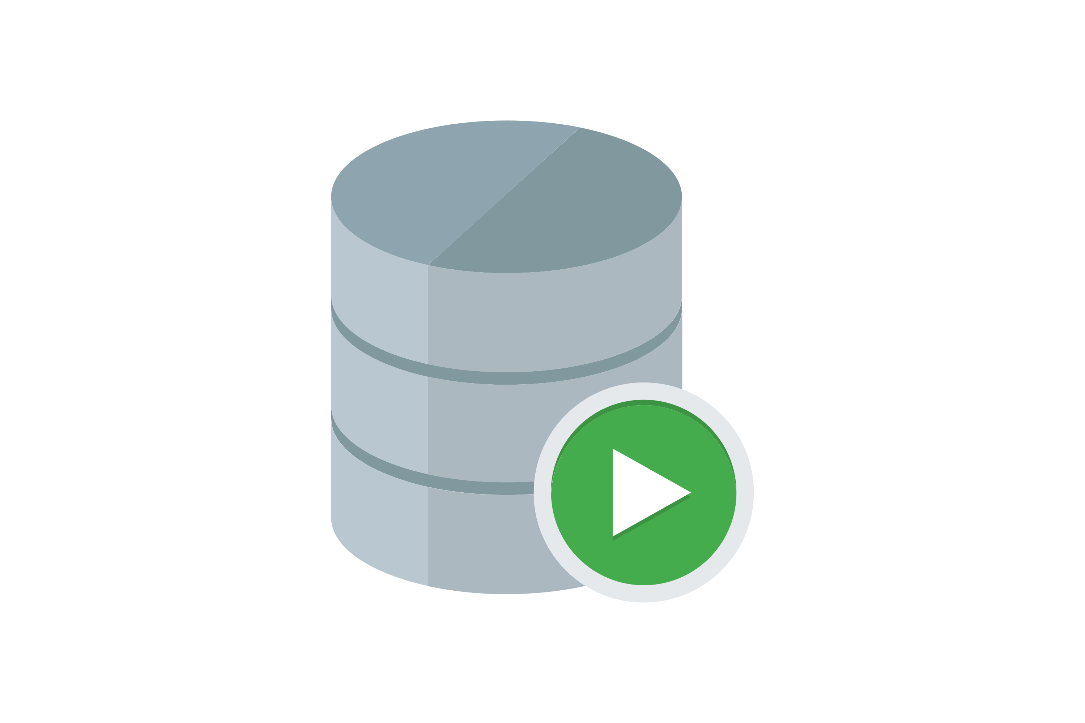
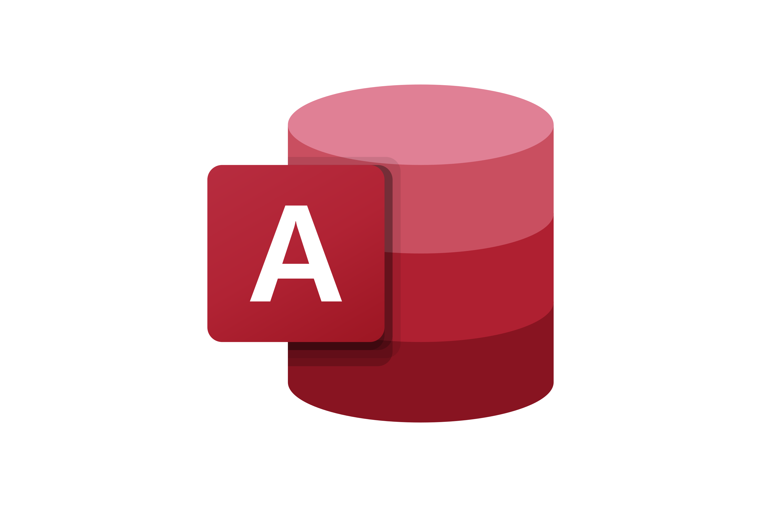
This Database Management System is designed to with the help of
Oracle Sql Developer and Ms Access.
Oracle Sql Developer is used as backend for this database to create tables with complex requirements for each field.
Ms Access is used as front end of this project. The forms and relationships are designed with an interface that is both easy to understand and can display data with complex queries

Slide 3
First, the tables were created in Oracle. The table for student information and grades was created using fields such as StudentId and date of birth, each defined with their relevant data type.
Oracle Sql developer is a reliable software to store and run queries on these tables with a vast amount of records.
The key features of this system include:
A comprehensive structure
Relational database structure with referential integrity
Scalable and high performance model

Slide 4
Next, the Sql server is connected with Ms Access. This software is an accessible and easy to use database management system with a comprehensive interface.
Using Ms Access, the relationships between each table were defined and referential integrity was maintained.
The key features of this system include:
Course enrollment and management
Automated GPA calculation
Forms and reports for storing and retrieving data

Slide 5
Both projects were linked using ODBC driver which ensures real-time connection between the two. This allows users to enter and append records simply usng Ms Access and without using complex Sql queries.
This also ensures that the data is backed up and cannot be accidentally deleted or appended by the user. An efficient and integral transfer of data is maintained.
This Oracle-based system provides a professional-grade solution for managing grading and academic data, offering the reliability, scalability, and features necessary for institutions of all sizes

Slide 6
THANK YOU FOR
WATCHING

